Slide 1
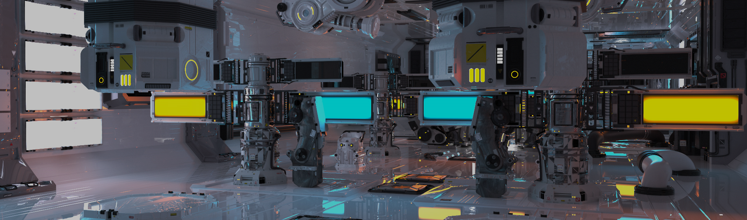
Roller Coaster 1
電腦圖學導論實習
Computer Graphics Lab | NTUST CSIE

Slide 2
Overview
Project 3
Parametric Polynomial Curves
Framework Overview
Draw Track
Draw Train
Run Train
Homework
Notes:
P3配分說明
加分/額外項說明

Slide 3
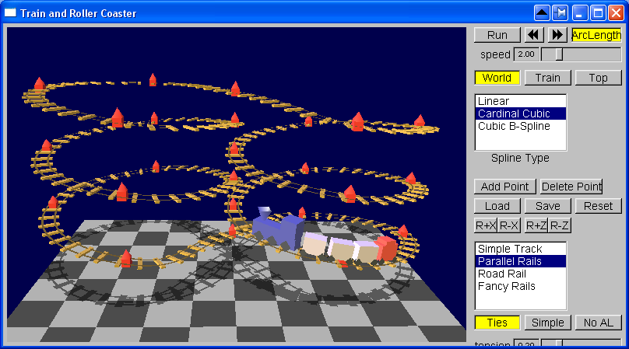
Project 3 - Roller Coaster

Slide 4
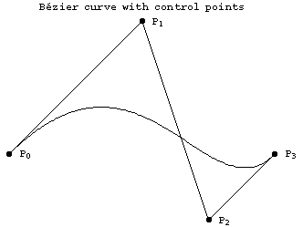
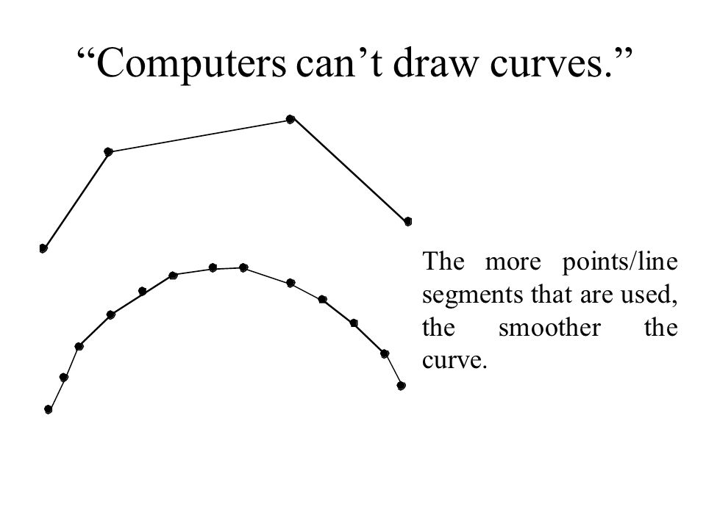
Parametric Polynomial Curves
Linear
Cardinal Cubic
Cubic B-Spline Curve
Notes:
Project要完成的三種軌道
四個控制點 透過不同的插值方式 可產生各種類型的曲線
三個控制點 -> 二次多項式
四個控制點 -> 三次多項式

Slide 5
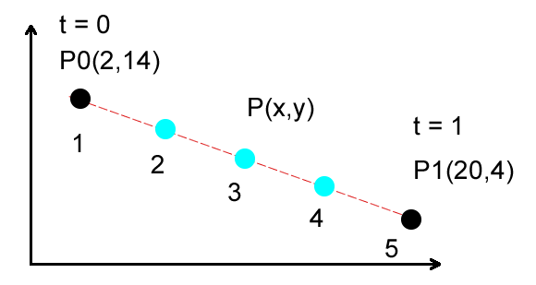
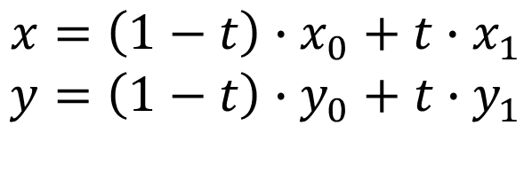
Linear Polynomial Curve
$$x=\left(1−t\right)∙x_{0}+t∙x_{1}$$
$$y=\left(1−t\right)∙y_{0}+t∙y_{1}$$

Slide 6
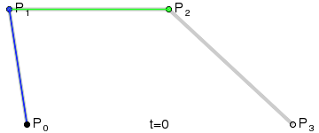
Cubic Bezier Curve
Notes:
Cubic Bezier 也是三次多項式，也使用四個控制點
但是只有p0及p3是曲線上的實際控制點
P1及p3則是用來控制曲線形狀

Slide 7
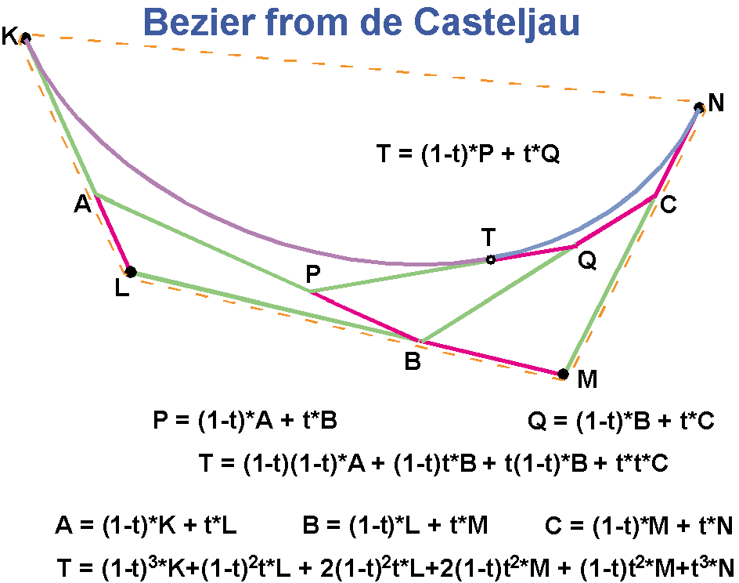
Cubic Bezier Curve
Notes:
貝茲的計算方式
計算 a, b ,c
計算 p, q
計算 t

Slide 8
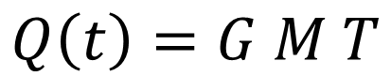
Formula
$$Q\left(t\right)=G M T$$

Slide 9
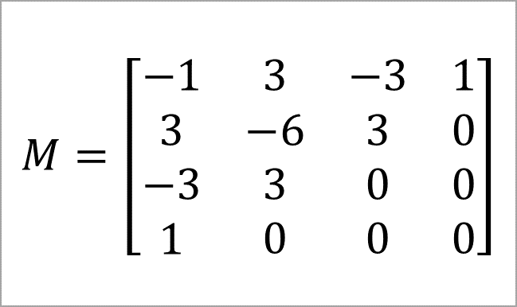
Cubic Bezier Curve
$$M=\left[\begin{aligned}−1 \\ 3 \\ −3 \\ 1\end{aligned}\begin{aligned} \\ \\ \\ \end{aligned}\begin{aligned}3 \\ −6 \\ 3 \\ 0\end{aligned}\begin{aligned} \\ \\ \\ \end{aligned}\begin{aligned}−3 \\ 3 \\ 0 \\ 0\end{aligned}\begin{aligned} \\ \\ \\ \end{aligned}\begin{aligned}1 \\ 0 \\ 0 \\ 0\end{aligned}\right]$$
Notes:
貝茲: p0, p3在控制點上
Cardinal: p0, p1, p2, p3都在控制點上
B-Spline: 都不在

Slide 10
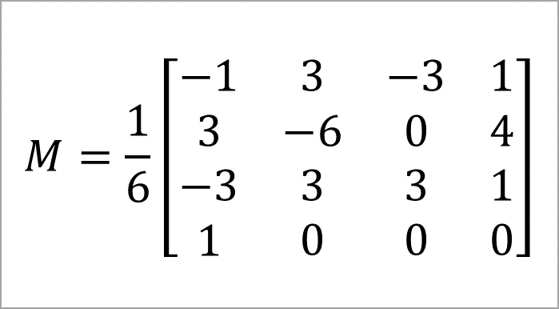
cubic B-spline
$$M=\frac{1}{6}\left[\begin{aligned}−1 \\ 3 \\ −3 \\ 1\end{aligned}\begin{aligned} \\ \\ \\ \end{aligned}\begin{aligned}3 \\ −6 \\ 3 \\ 0\end{aligned}\begin{aligned} \\ \\ \\ \end{aligned}\begin{aligned}−3 \\ 0 \\ 3 \\ 0\end{aligned}\begin{aligned} \\ \\ \\ \end{aligned}\begin{aligned}1 \\ 4 \\ 1 \\ 0\end{aligned}\right]$$

Slide 11
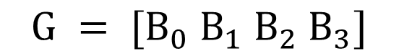
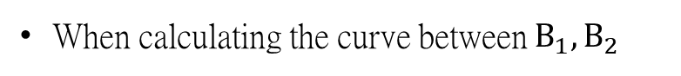
Fill the value
When calculating the curve between $B_{1}, B_{2}$
$$G = [B_{0} B_{1} B_{2} B_{3}]$$
The position and orientation are also calculated using GMT.

Slide 12
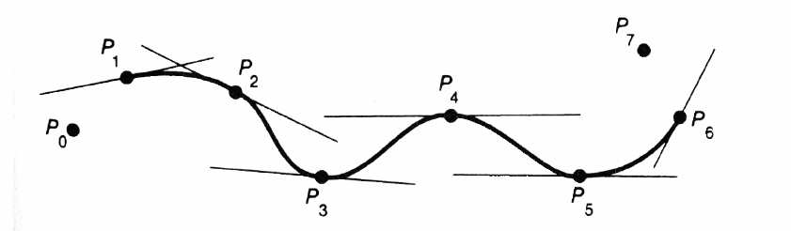
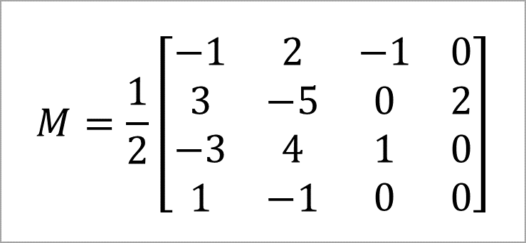
Cardinal
$$M=\frac{1}{2}\left[\begin{aligned}−1 \\ 3 \\ −3 \\ 1\end{aligned}\begin{aligned} \\ \\ \\ \end{aligned}\begin{aligned}2 \\ −5 \\ 4 \\ −1\end{aligned}\begin{aligned} \\ \\ \\ \end{aligned}\begin{aligned}−1 \\ 0 \\ 1 \\ 0\end{aligned}\begin{aligned} \\ \\ \\ \end{aligned}\begin{aligned}0 \\ 2 \\ 0 \\ 0\end{aligned}\right]$$
Notes:
Cardinal curves at tension = 0.5

Slide 13
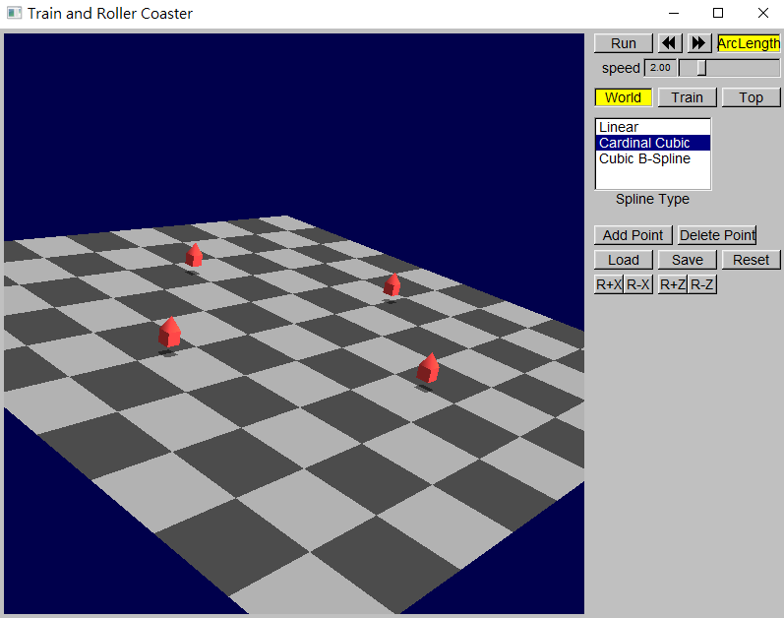
Framework Overview
Pnt3f
Track
read / load track
points
ControlPoint
position
orient
draw

Slide 14
Draw Track
TrainView.cpp
void TrainView::drawStuff(bool doingShadows)
{
// Draw the control points
// don't draw the control points if you're driving
// (otherwise you get sea-sick as you drive through them)
if (!tw->trainCam->value()) {
for(size_t i=0; i<m_pTrack->points.size(); ++i) {
if (!doingShadows) {
if ( ((int) i) != selectedCube)
glColor3ub(240, 60, 60);
else
glColor3ub(240, 240, 30);
}
m_pTrack->points[i].draw();
}
}
// draw the track
//####################################################################
// TODO:
// call your own track drawing code
//####################################################################
#ifdef EXAMPLE_SOLUTION
drawTrack(this, doingShadows);
#endif

Slide 15
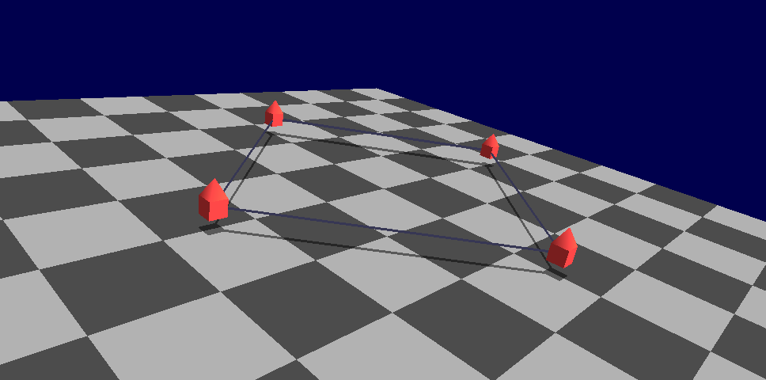
Draw Track

Slide 16
Draw Track
for (size_t i = 0; i < m_pTrack->points.size(); ++i){
// pos
Pnt3f cp_pos_p1 = m_pTrack->points[i].pos;
Pnt3f cp_pos_p2 = m_pTrack->points[(i + 1) % m_pTrack -> points.size()].pos;
// orient
Pnt3f cp_orient_p1 = m_pTrack->points[i].orient;
Pnt3f cp_orient_p2 = m_pTrack->points[(i + 1) % m_pTrack -> points.size()].orient;
float percent = 1.0f / DIVIDE_LINE;
float t = 0;
Pnt3f qt = (1 - t) * cp_pos_p1 + t * cp_pos_p2;
//…
}

Slide 17
Draw Track (cont.)
for (size_t i = 0; i < m_pTrack->points.size(); ++i){
//initialize…
for (size_t j = 0; j < DIVIDE_LINE; j++) {
Pnt3f qt0 = qt;
t += percent;
qt = (1 - t) * cp_pos_p1 + t * cp_pos_p2;
Pnt3f qt1 = qt;
glLineWidth(3);
glBegin(GL_LINES);
if (!doingShadows)
glColor3ub(32, 32, 64);
glVertex3f(qt0.x, qt0.y, qt0.z);
glVertex3f(qt1.x, qt1.y, qt1.z);
glEnd();
glLineWidth(1);
}
}

Slide 18
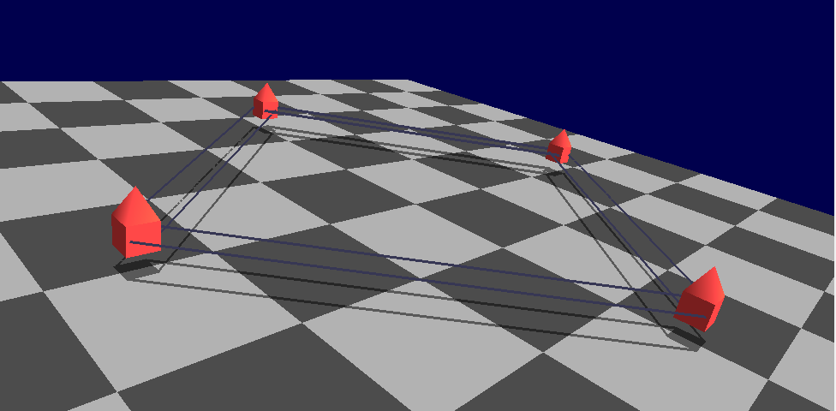
Draw Track

Slide 19
Draw Track
// cross
Pnt3f orient_t = (1 - t) * cp_orient_p1 + t * cp_orient_p2;
orient_t.normalize();
Pnt3f cross_t = (qt1 - qt0) * orient_t;
cross_t.normalize();
cross_t = cross_t * 2.5f;
glBegin(GL_LINES);
glVertex3f(qt0.x + cross_t.x, qt0.y + cross_t.y, qt0.z + cross_t.z);
glVertex3f(qt1.x + cross_t.x, qt1.y + cross_t.y, qt1.z + cross_t.z);
glVertex3f(qt0.x - cross_t.x, qt0.y - cross_t.y, qt0.z - cross_t.z);
glVertex3f(qt1.x - cross_t.x, qt1.y - cross_t.y, qt1.z - cross_t.z);
glEnd();
glLineWidth(1);

Slide 20
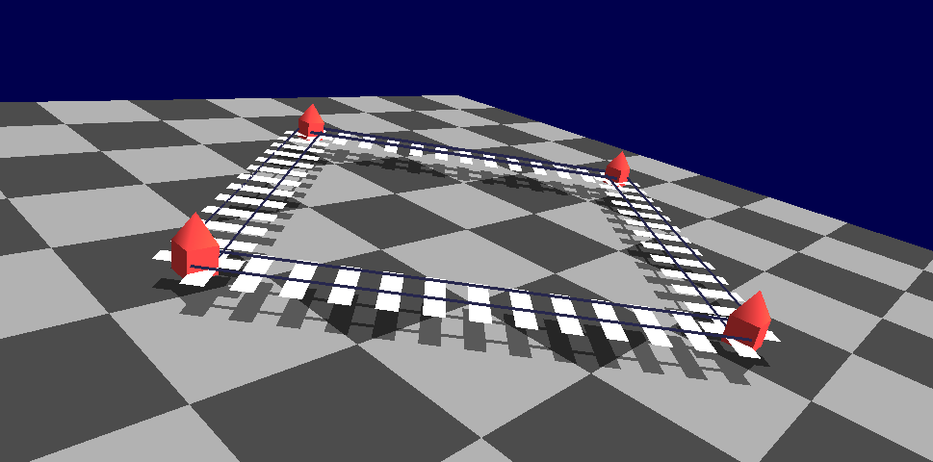
Draw Track

Slide 21
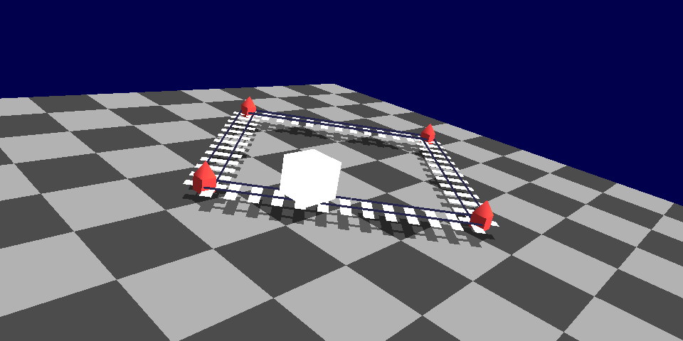
Draw Train

Slide 22
Draw Train
glBegin( GL_QUADS );
glTexCoord2f( 0.0f , 0.0f );
glVertex3f( qt.x - 5 , qt.y - 5 , qt.z - 5 );
glTexCoord2f( 1.0f , 0.0f );
glVertex3f( qt.x + 5 , qt.y - 5 , qt.z - 5 );
glTexCoord2f( 1.0f , 1.0f );
glVertex3f( qt.x + 5 , qt.y + 5 , qt.z - 5 );
glTexCoord2f( 0.0f , 1.0f );
glVertex3f( qt.x - 5 , qt.y + 5 , qt.z - 5 );
// draw the train
//###################################################
// TODO:
// call your own train drawing code
//###################################################
#ifdef EXAMPLE_SOLUTION
// don't draw the train if you're looking out the front window
if (!tw->trainCam->value())
drawTrain(this, doingShadows);
#endif

Slide 23
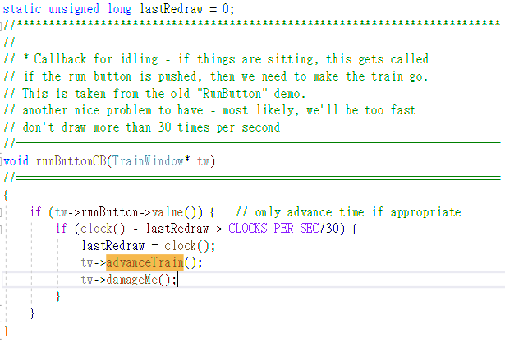
Run Train

Slide 24
Run Train
TrainWindow.cpp
void advanceTrain(float dir = 1)
{
trainview->t_time += (dir / m_Track.points.size() / (trainview -> DIVIDE_LINE / 40));
if( trainview->t_time > 1.0f )
trainview->t_time -= 1.0f ;
}

Slide 25
Hw06(8%)
Draw running train don't consider orient
Draw curve track and sleeper don't consider orient(7%)
Linear(2%)
B-Spline(5%)
參與(1%)
Notes:
火車: 最少要有立方體
枕木: 最少要是平面

